Slide 1
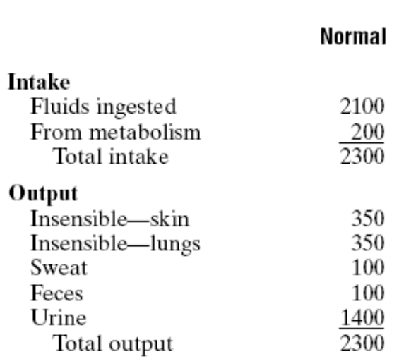
Daily Intake and Output of Water (ml/day)

Slide 2
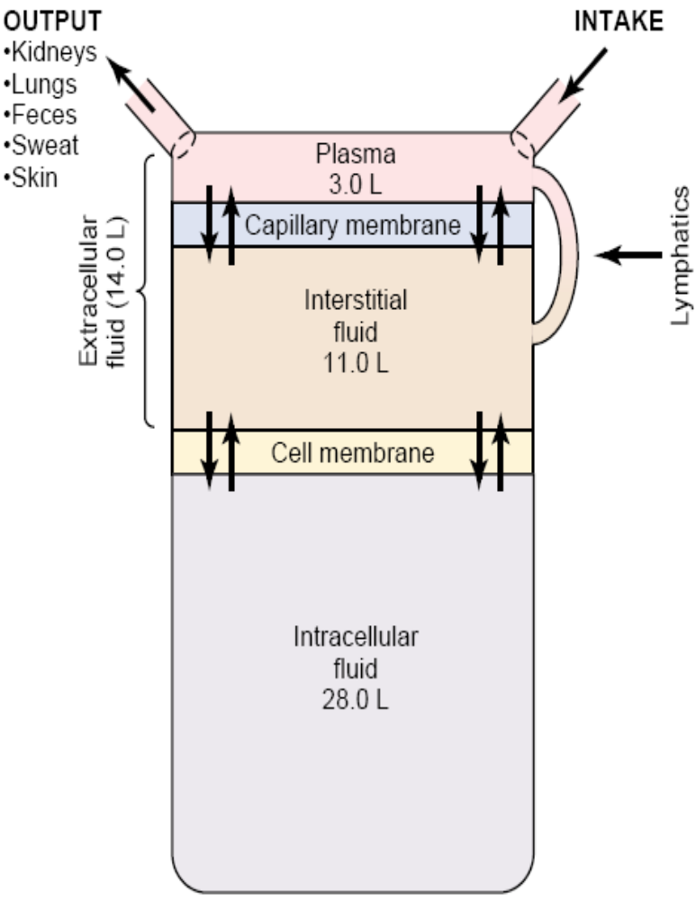
Body Fluid Compartments
In the average 70-kilogram adult human, the total body water is about 60 per cent of the body weight, or about 42 liters.
About 28 of the 42 liters of fluid in the body are inside the 75 trillion cells and are collectively called the intracellular fluid. (40 per cent of the total body weight)
Extracellular fluid accounts for about 20 per cent of the body weight, or about 14 liters.

Slide 3
Conti…….
transcellular fluid, which includes fluid in the synovial, peritoneal, pericardial, and intraocular spaces, as well as the cerebrospinal fluid about 1 to 2 ltrs.

Slide 4
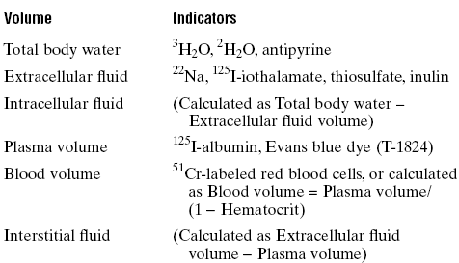
Measurement of Body Fluid Volumes

Slide 5
The Urinary System
Functions of urinary system
Anatomy of kidney
Urine formation
  glomerular filtration
  tubular reabsorption
  tubular secretion
Urine storage and elimination

Slide 6
Kidney Functions
Filters blood plasma
  returns useful substances to blood
  eliminates waste
Regulates
  osmolarity of body fluids, blood volume, BP
  acid base balance
Secretes
  renin and erythropoietin
Detoxifies free radicals and drugs
Gluconeogenesis

Slide 7
Excretion
Separation of wastes from body fluids and eliminating them; by four systems
  respiratory: CO₂
  integumentary: water, salts, lactic acid, urea
  digestive: water, salts, CO₂, lipids, bile pigments, cholesterol
  urinary: many metabolic wastes, toxins, drugs, hormones, salts, H⁺ and water

Slide 8
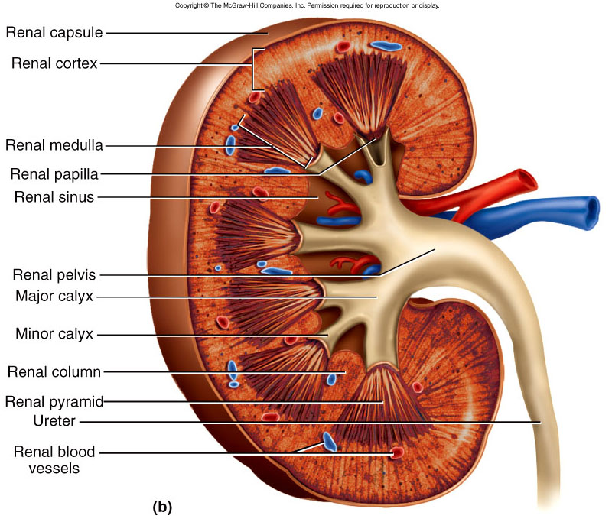
Anatomy of Kidney
Renal cortex: outer 1 cm
Renal medulla: renal columns, pyramids - papilla
Lobe of kidney: pyramid and it’s overlying cortex

Slide 9
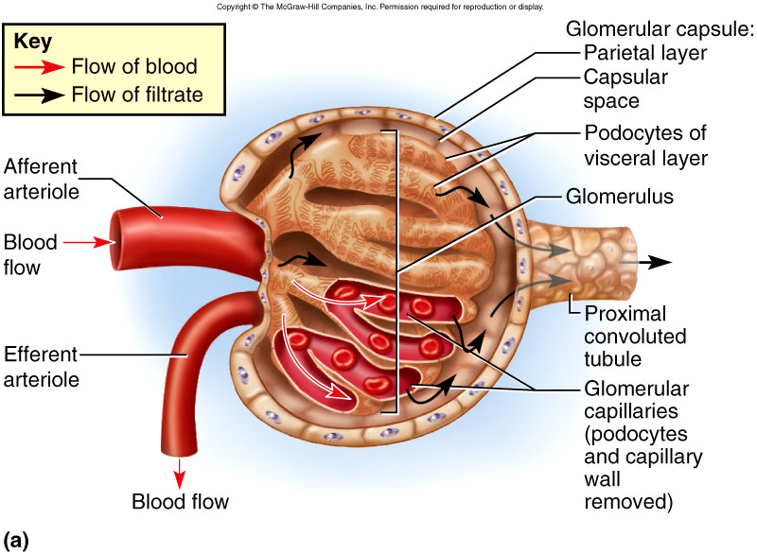
Lobe of Kidney

Slide 10
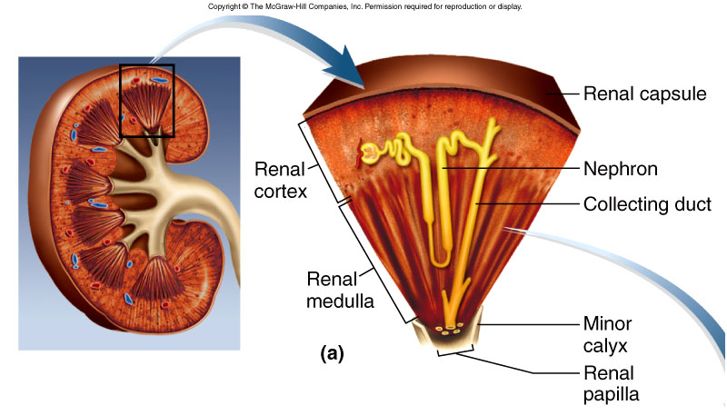
Renal Corpuscle
Glomerular filtrate collects in capsular space, flows into renal tubule

Slide 11
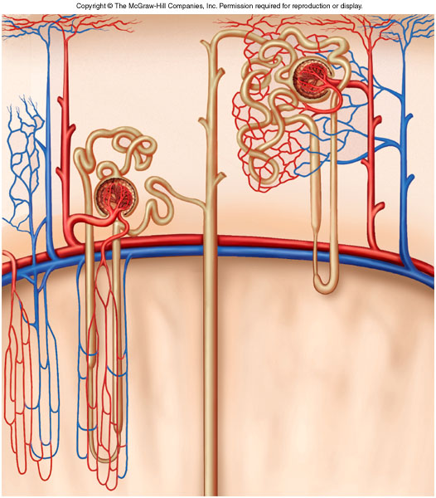
Renal (Uriniferous) Tubule
Proximal convoluted tubule (PCT)
  longest, most coiled
Nephron loop - U shaped; descending and ascending limbs
  thick segment, initial part of descending limb and part or all of ascending limb, active transport of salts
  thin segment, very water permeable
Distal convoluted tubule (DCT)

Slide 12
Renal (Uriniferous) Tubule 2
Collecting duct
  several DCT’s join
Flow of glomerular filtrate:
  glomerular capsule → PCT → nephron loop → DCT → collecting duct → papillary duct → minor calyx → major calyx → renal pelvis → ureter → urinary bladder → urethra

Slide 13
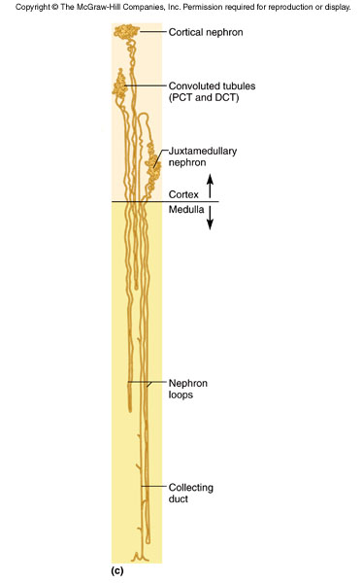
Nephrons
True proportions of nephron loops to convoluted tubules shown
Cortical nephrons (85%)
  short nephron loops
  efferent arterioles branch off peritubular capillaries
Juxtamedullary nephrons (15%)
  very long nephron loops, maintain salt gradient, helps conserve water

Slide 14
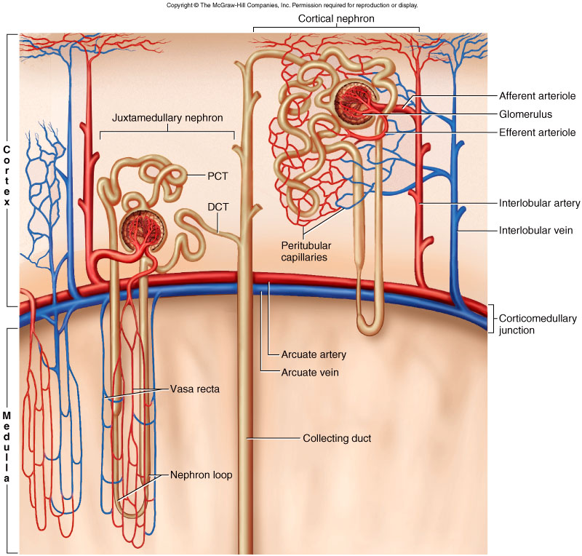
Nephron Diagram
Peritubular capillaries shown only on right

Slide 15
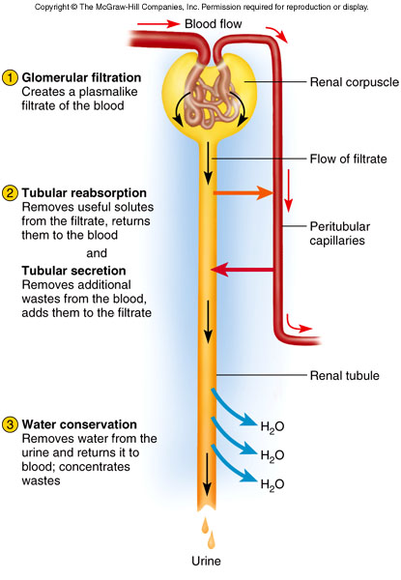
Urine Formation Preview

Slide 16
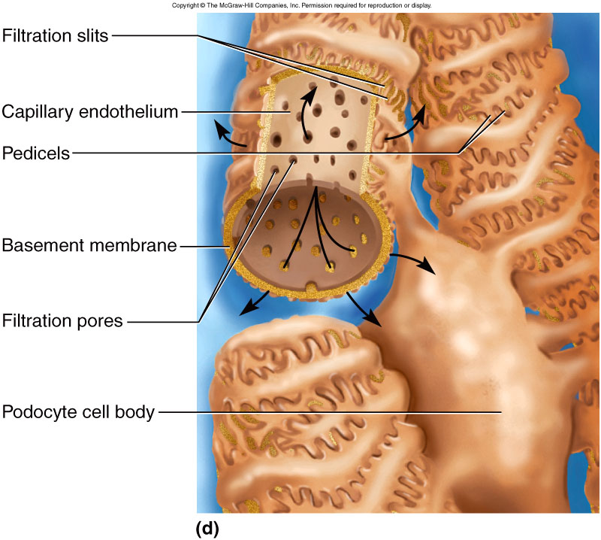
Filtration Membrane Diagram

Slide 17
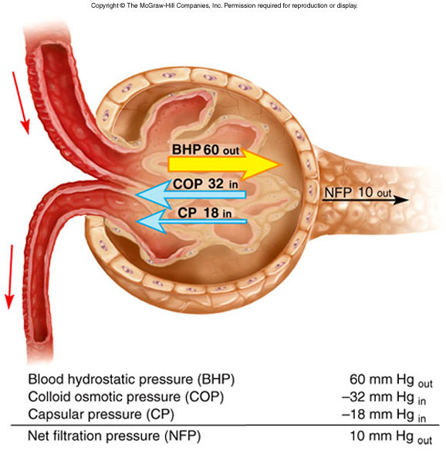
Filtration Pressure

Slide 18
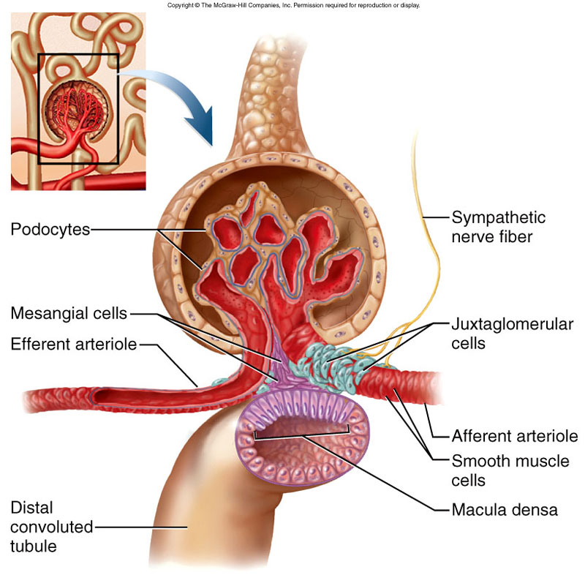
Juxtaglomerular Apparatus
- vasomotion
- monitor salinity

Slide 19
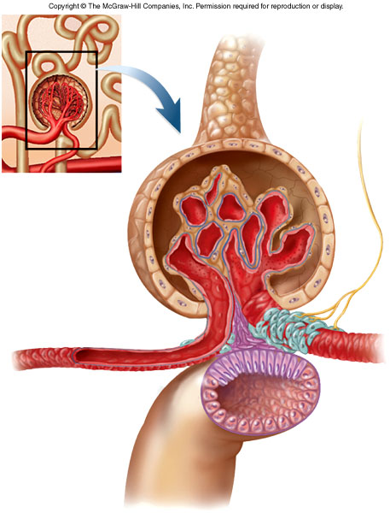
Renal Autoregulation of GFR
↑ BP → constrict afferent arteriole, dilate efferent
↓ BP → dilate afferent arteriole, constrict efferent
Stable for BP range of 80 to 170 mmHg (systolic)
Cannot compensate for extreme BP

Slide 20
Renal Autoregulation of GFR
Myogenic mechanism
  ↑ BP → stretches afferent arteriole → afferent arteriole constricts → restores GFR
Tubuloglomerular feedback
  Macula densa on DCT monitors tubular fluid and signals juxtaglomerular cells (smooth muscle, surrounds afferent arteriole) to constrict afferent arteriole to ↓ GFR

Slide 21
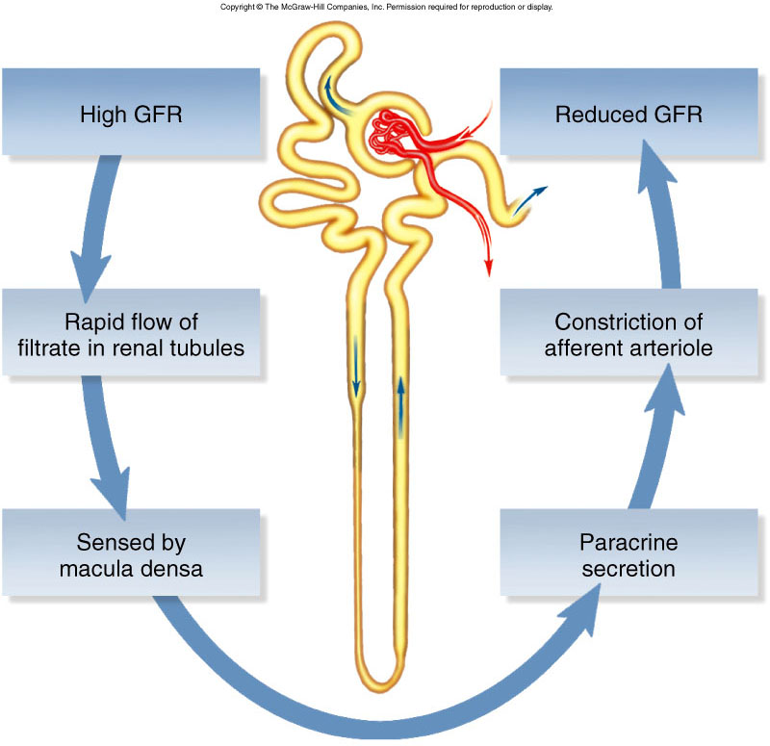
Negative Feedback Control of GFR

Slide 22
Tubular Reabsorption and Secretion

Slide 23
Proximal Convoluted Tubules (PCT)
Reabsorbs 65% of GF to peritubular capillaries
Great length, prominent microvilli and abundant mitochondria for active transport

Slide 24
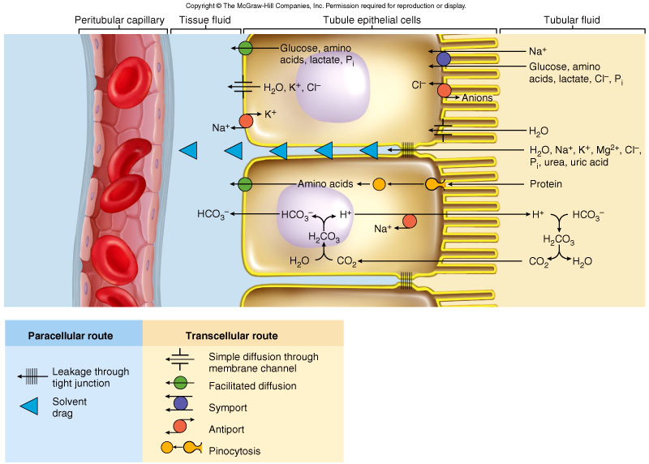
Mechanisms of Reabsorption in the Proximal Convoluted Tubule

Slide 25
Tubular Secretion of PCT and Nephron Loop
Waste removal
  urea, uric acid, bile salts, ammonia, catecholamines, many drugs
Acid-base balance
  secretion of hydrogen and bicarbonate ions regulates pH of body fluids
Primary function of nephron loop
  water conservation
  generates salinity gradient, allows CD to conc. urine
  also involved in electrolyte reabsorption

Slide 26
DCT
referred as the diluting segment
Principal cells – receptors for hormones; involved in salt/water balance, Reabsorb Sodium and Secrete Potassium
Intercalated cells – involved in acid/base balance, Secrete Hydrogen and Reabsorb Bicarbonate and Potassium Ions

Slide 27
DCT and Collecting Duct
Aldosterone effects
  ↓ BP → renin release → angiotensin II formation
  angiotensin II stimulates adrenal cortex
  adrenal cortex secretes aldosterone
    promotes Na⁺ reabsorption → promotes water reabsorption → ↓ urine volume → maintains BP

Slide 28
DCT and Collecting Duct
Effect of ADH
  dehydration stimulates hypothalamus
  hypothalamus stimulates posterior pituitary
  posterior pituitary releases ADH
  ADH ↑ water reabsorption
  ↓ urine volume

Slide 29
Control of Water Loss
Producing hypotonic urine
  NaCl reabsorbed by cortical CD
  water remains in urine
Producing hypertonic urine
  dehydration → ↑ ADH → ↑ aquaporin channels, ↑ CD’s water permeability
  more water is reabsorbed
  urine is more concentrated

Slide 30
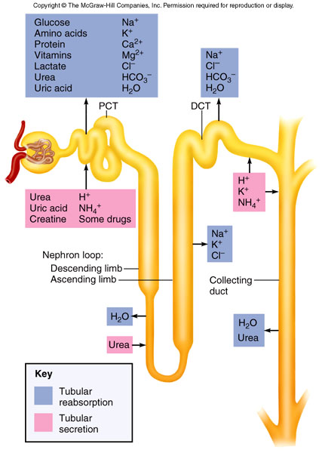
Sodium, potassium and calcium electrolyte balance

Slide 31
Composition and Properties of Urine
Appearance
  almost colorless to deep amber; yellow color due to urochrome, from breakdown of hemoglobin (RBC’s)
Odor - as it stands bacteria degrade urea to ammonia
Specific gravity
  density of urine ranges from 1.001 -1.028
Osmolarity - (blood - 300 mOsm/L) ranges from
50 mOsm/L to 1,200 mOsm/L in dehydrated person
pH - range: 4.5 - 8.2, usually 6.0
Chemical composition: 95% water, 5% solutes
  urea, NaCl, KCl, creatinine, uric acid

Slide 32
Urine Volume
Normal volume - 1 to 2 L/day
Polyuria > 2L/day
Oliguria < 500 mL/day
Anuria - 0 to 100 mL/day

Slide 33
Urine Storage and Elimination
Ureters (about 25 cm long)
  from renal pelvis passes dorsal to bladder and enters it from below, with a small flap of mucosa that acts as a valve into bladder
  3 layers
    adventitia
    muscularis - 2 layers of smooth muscle
      urine enters, it stretches and contracts in peristaltic wave
    mucosa - transitional epithelium
  lumen very narrow, easily obstructed

Slide 34
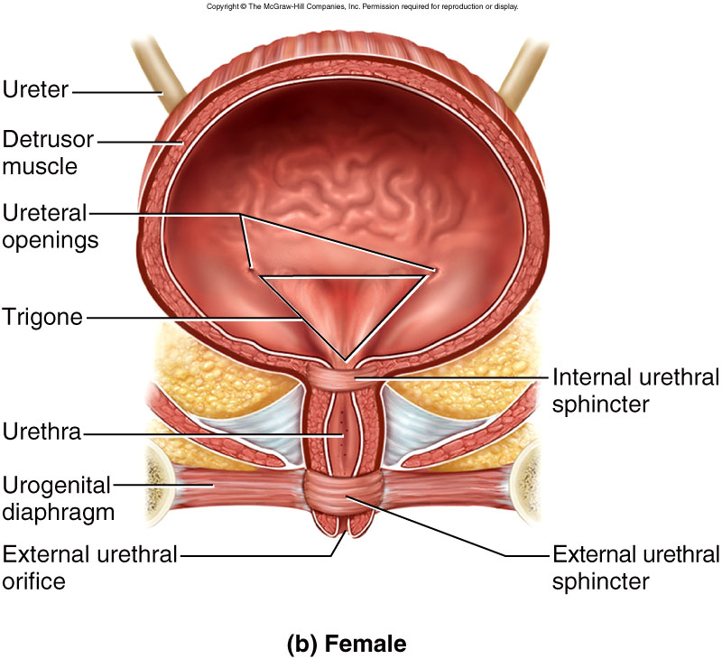
Urinary Bladder and Urethra - Female

Slide 35
Urinary Bladder
Located in pelvic cavity, posterior to pubic symphysis
3 layers
  parietal peritoneum, superiorly; fibrous adventitia rest
  muscularis: detrusor muscle, 3 layers of smooth muscle
  mucosa: transitional epithelium
trigone: openings of ureters and urethra, triangular
rugae: relaxed bladder wrinkled, highly distensible
capacity: moderately full - 500 ml, max. - 800 ml

Slide 36
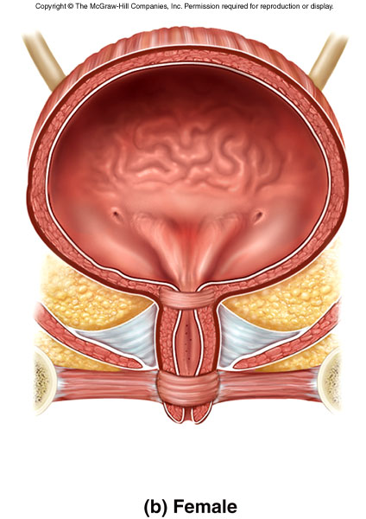
Female Urethra
3 to 4 cm long
External urethral orifice
  between vaginal orifice and clitoris
Internal urethral sphincter
  detrusor muscle thickened, smooth muscle, involuntary control
External urethral sphincter
  skeletal muscle, voluntary control

Slide 37
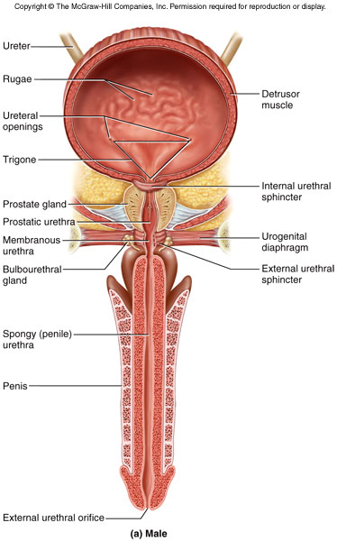
Male Bladder and Urethra
18 cm long
Internal urethral sphincter
External urethral sphincter
3 regions
  prostatic urethra
    during orgasm receives semen
  membranous urethra
    passes through pelvic cavity
  spongy urethra

Slide 38
Voiding Urine - Micturition
200 ml urine in bladder, stretch receptors send signal to sacral spinal cord
Signals ascend to
  inhibitory synapses on sympathetic neurons
  micturition center (integrates info from amygdala, cortex)
Signals descend to
  further inhibit sympathetic neurons
  stimulate parasympathetic neurons
Result
  urinary bladder contraction
  relaxation of internal urethral sphincter
External urethral sphincter - corticospinal tracts to sacral spinal cord inhibit somatic neurons - relaxes

Slide 39
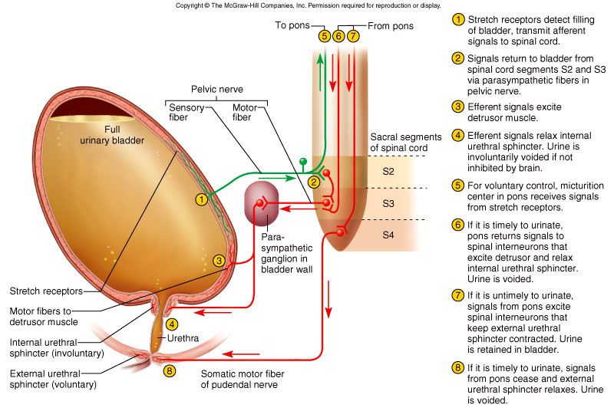
Neural Control of Micturition

Slide 40
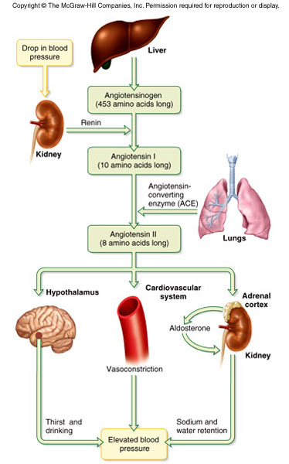
Renin-Angiotensin-Aldosterone

Slide 41
Dialysis
The separation of large solutes from smaller ones by diffusion through a selectively permeable membrane.
One method of dialysis is hemodialysis, which directly filters the patient’s blood by removing wastes and excess electrolytes and fluid and then returning the cleansed blood to the patient.
Blood removed from the body is delivered to a hemodialyzer (artificial kidney). Inside the hemodialyzer, blood flows through a dialysis membrane, which contains pores large enough to permit the diffusion of small solutes.

Slide 42
A special solution, called the dialysate, is pumped into the hemodialyzer so that it surrounds the dialysis membrane.
The dialysate is specially formulated to maintain diffusion gradients that remove wastes from the blood (for example, urea, creatinine, uric acid, excess phosphate, potassium, and sulfate ions) and add needed substances (for example, glucose and bicarbonate ions) to it.
An anticoagulant (heparin) is added to prevent blood from clotting in the hemodialyzer. As a rule, most people on hemodialysis require about 6–12 hours a week.

Slide 43
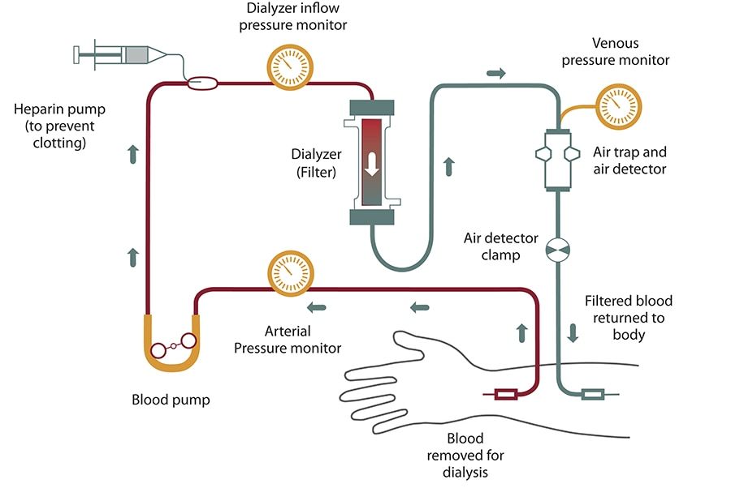

Slide 44
Calcium, magnesium, or uric acid salts in urine may crystallize and precipitate in the renal pelvis, forming renal calculi or kidney stones.
Most calculi are under 5 mm in diameter and pass through the urinary tract without causing problems. However, l\Larger calculi (>5mm) can obstruct a ureter and block urine drainage. Increasing pressure in the kidney causes excruciating pain.
Pain also occurs during peristalsis when the contracting ureter wall closes in on the sharp calculi.
Predisposing conditions are frequent bacterial infections of the urinary tract, urine retention, high blood levels of calcium, and alkaline urine. Surgical removal of calculi has been almost entirely replaced by shock wave lithotripsy, a noninvasive procedure that uses ultrasonic shock waves to shatter the calculi. ✚

